Slide 1
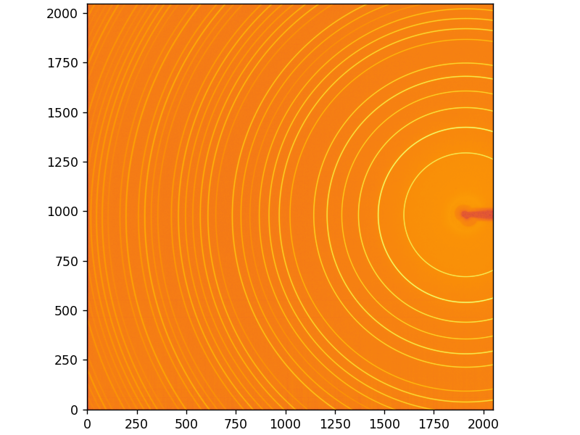
Using pyFAI-calib2 GUI for area-detector calibration
By Kevin Morell and Peter Meshkov

Slide 2
What is pyFAI?
pyFAI is a Python library which helps convert XRD detector images to an Intensity vs 2Theta CSV file
You will need to have Python installed on your machine
https://www.python.org/downloads/
You will also need the pyFAI package installed in a Python environment
https://pypi.org/project/pyFAI/
Otherwise, no other installation is necessary

Slide 3

Installing Python
Python installation is different based on your OS
Windows: go to the Microsoft Store and find the most recent version of python. It will install to a hidden folder and again will not have to be used beyond setup wizard.
MacOS: download from python site and follow setup guide https://www.python.org/downloads/macos/
Linux: run “sudo apt install python3” in terminal

Slide 4

Conda
Package manager for Python
Anaconda is heavier version, with almost every package you could possibly need preinstalled
Miniconda is lighter
Neither version comes with pyFAI
Download for any OS here: https://www.anaconda.com/download/success
Follow setup guide
It may ask if you want to open terminal in your python environment by default; select yes

Slide 5
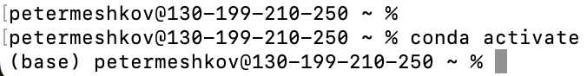
Your Python Environment
Activate your Python environment in terminal
This is easy to do with conda, just enter the command “conda activate” in terminal
To deactivate, enter “conda deactivate”
If you are using Python venv instead of conda, follow these instructions https://docs.python.org/3/library/venv.html (I recommend using conda)
You should have (base) in front of your username if the environment is active
If using Python virtual environment, it may be (venv) or something else
Now you can call system level Python commands in terminal (ex: “pip install”)

Slide 6
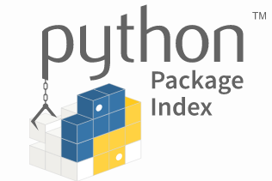
pip Installer
pip is a tool that installs python packages
Python versions >=3.4 come with pip preinstalled.
Ensure pip is installed with the command “pip --version”
If it is missing, try the following commands in terminal:
Windows: “py -m ensurepip --upgrade”
MacOS: “python -m ensurepip --upgrade”
Linux: “python -m ensurepip --upgrade”
Called through terminal
Can be called in Python shell (in a Python program) by including an exclamation mark before the command
Conda has an equivalent command “conda install”

Slide 7
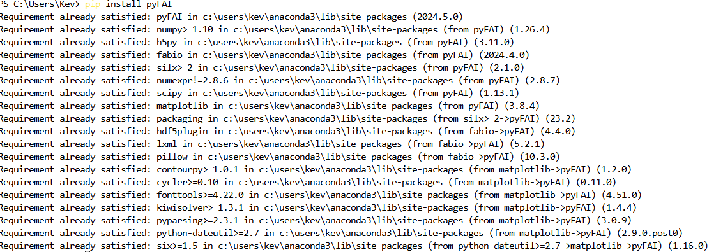
Install pyFAI
pip should automatically install all of the required modules for pyFAI

Slide 8
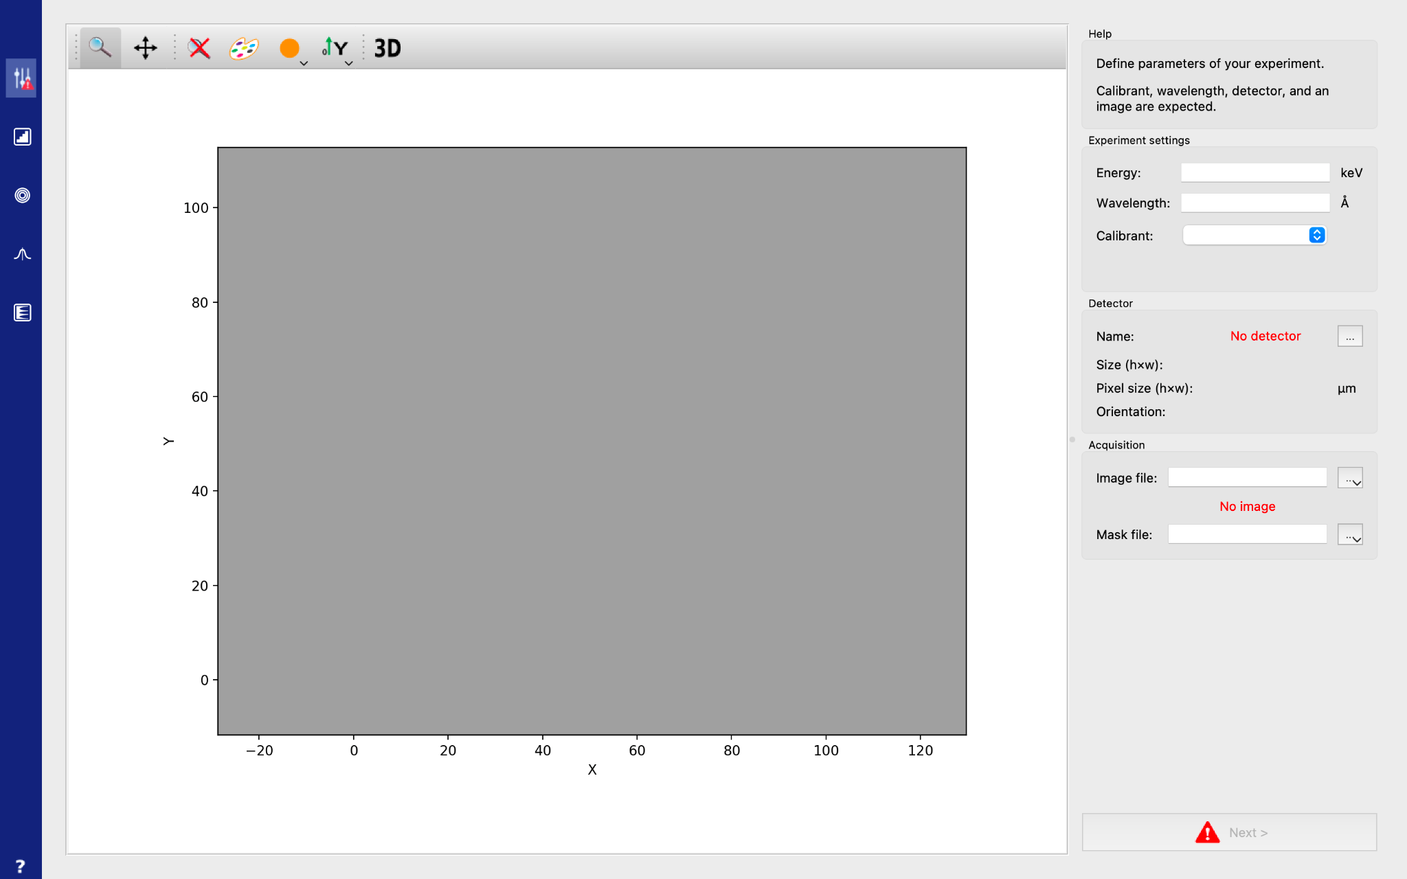
Install pyFAI cont.
If “pip install pyFAI” doesn’t work, ensure your terminal is opened in the Python environment
I.e. you see (base) or (venv) or some custom made environment name in front of your name
Now you can run the pyFAI graphical user interface using the command “pyFAI-calib2” in terminal; the interface shown below should pop up
Your directory location in terminal doesn’t matter, the GUI allows you to select files from anywhere

Slide 9
PONI File
In order to create the calibration (PONI) file you need a few key things:
The data .tiff file (detector image) saved locally
The wavelength or energy your data was taken with
The name of the detector used to collect your data
The species of the sample or a .cif file for that species (if it is not present in the drop down in pyFAI)

Slide 10
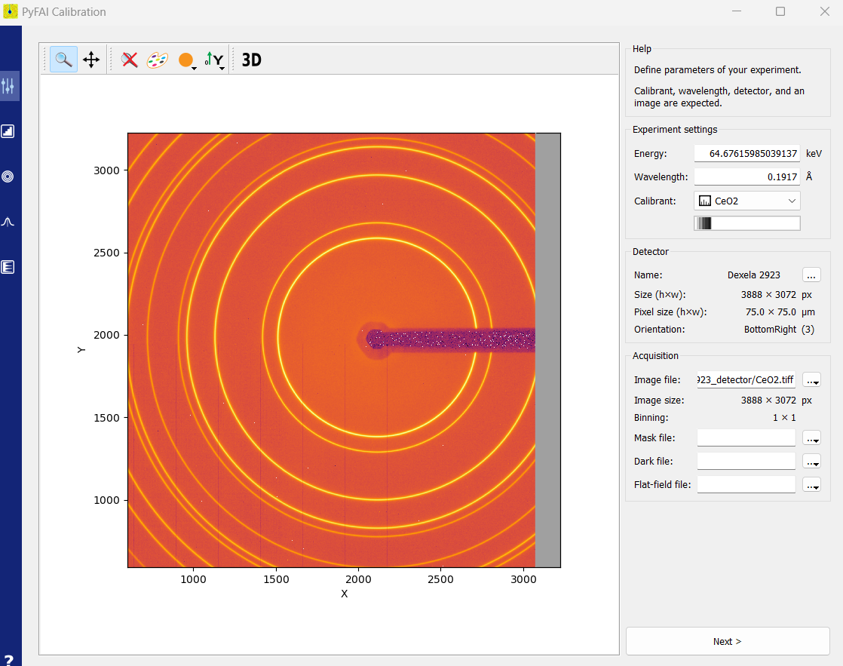
Calibration data entry
Enter wavelength or energy here
Enter calibrant species or .cif here
Enter detector here
Enter image file here
Once all fields are filled, press next

Slide 11
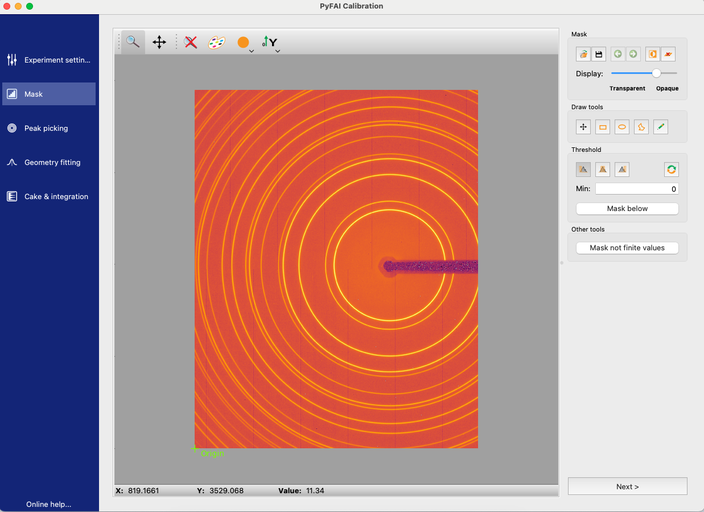
Mask intro
Masks are files that filter out unwanted data from your detector readings
For example, in the figure on the left, you can see where our beam stop and arm were blocking light
However, some imperfections like dead pixels are harder to spot
Calib2 mask provides a few tools for these situations
Mask toolbar
Helpful information

Slide 12
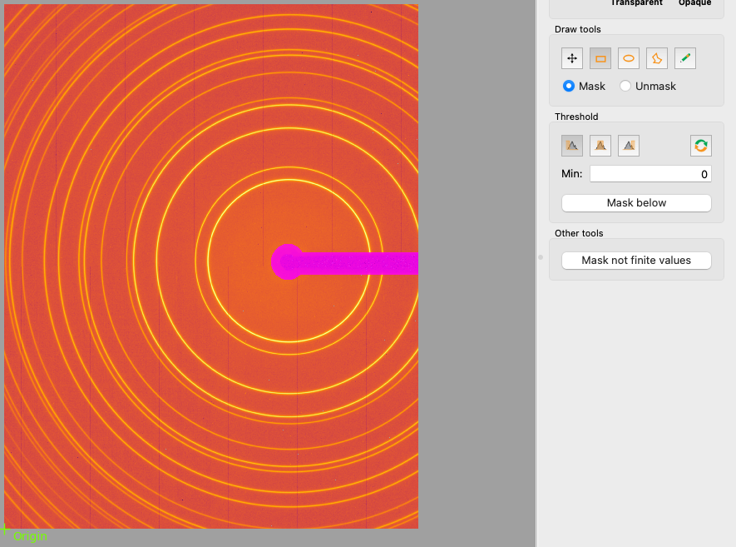
Drawing a mask
First we handle the beamstop
The two circled Draw Tools are the most helpful, one draws ellipses and the other polygons
Use the ellipse tool to circle the beamstop and the polygon for the arm.
Once selected, the masked areas should be pink as shown.

Slide 13
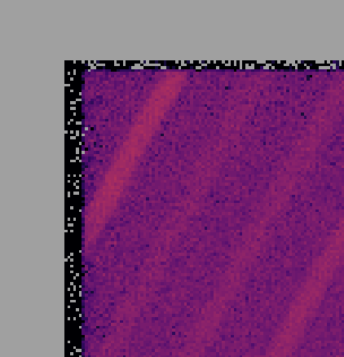
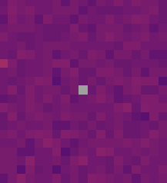
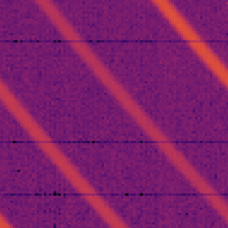
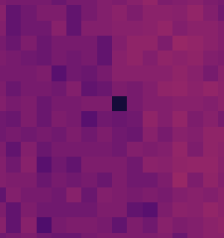
Pixel problems
Next we mask irregular pixels
Depending on the condition of your detector, you may experience different irregularities.
As as seen in the top two images, border defects and negative values are easy to handle with calib2.
As seen in the bottom two, defective lines and non-negative outliers are better handled by the median filter described in notebook 003.
(note: this is a new example file, as the other one didn’t have many irregularities)

Slide 14
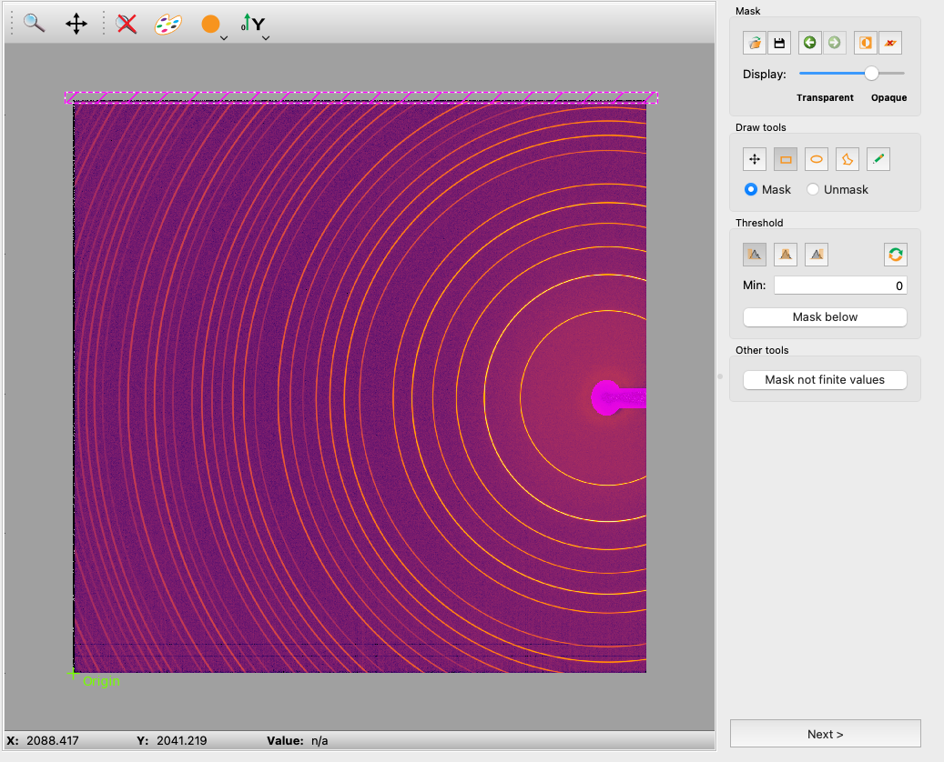
Masking edges
For irregularities on the boundary:
Use the rectangle tool to mask the defective section. The coordinates on the bottom may be helpful as you need to be completely zoomed out to mask the entire edge.

Slide 15
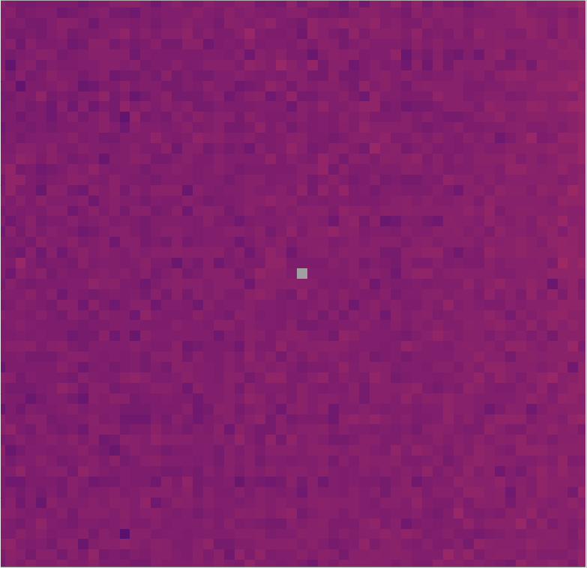
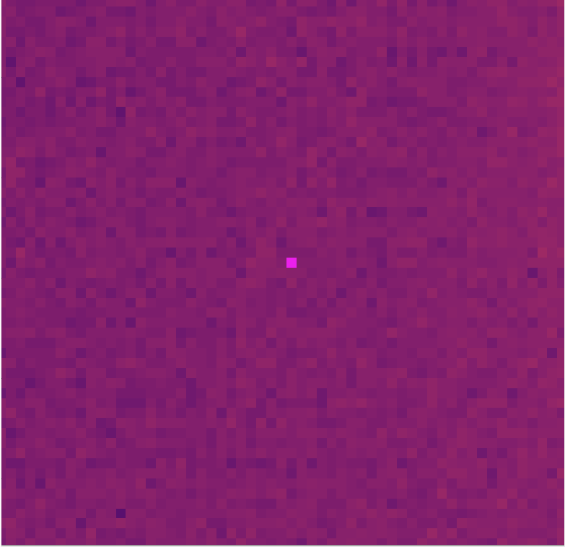
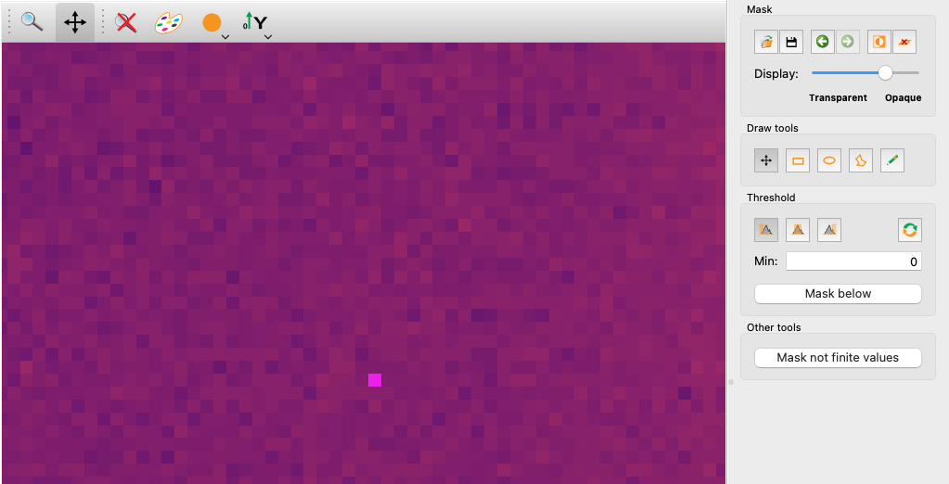
Masking negatives
For the negative pixel case:
Under Threshold select the left “Mask… below given threshold” option.
Enter a minimum of zero.
Press Mask below.
Once you have created your mask, press next.

Slide 16
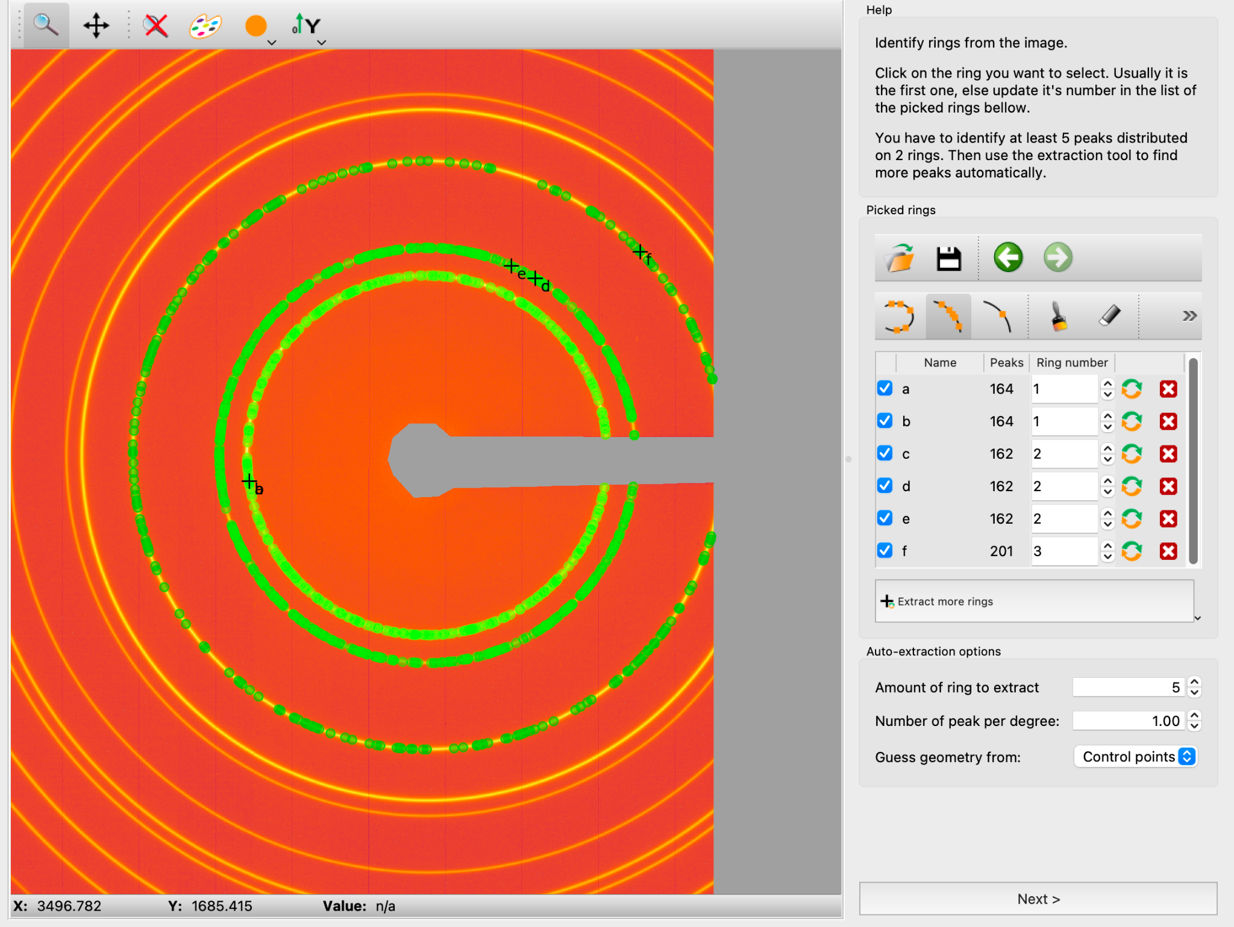
Ring Selection for Calibration: Manual
Once masking is complete, start the ring selection process. Choose the number of rings to extract (5 is usually fine), and left click on a ring to select.
A table of labeled rings should appear; make sure the ring number matches the number you selected.
Try to select each ring multiple times.
(We are back to the original example file)

Slide 17
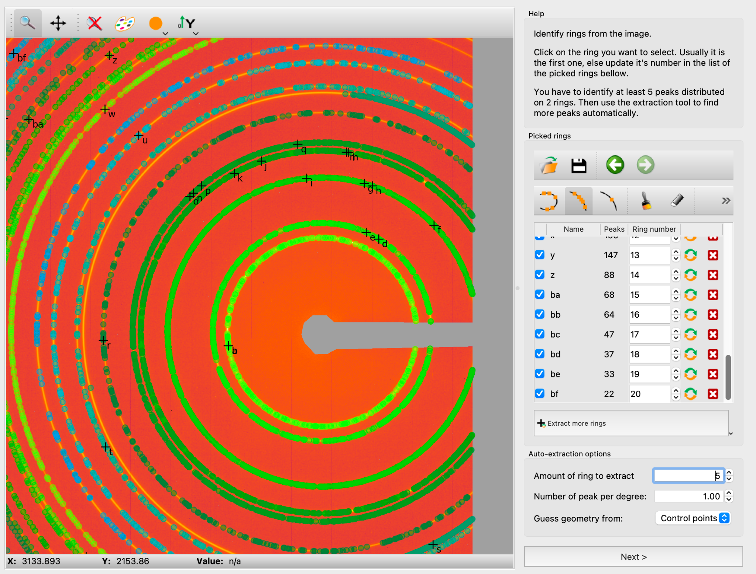
Ring Selection for Calibration: Automated
After 5 manual rings, the “Extract more rings” feature should be able to extract the rest of the rings for you. Ratatouille!
Make sure to double check the rings it extracts, and also if it seems necessary, select some of the outer rings multiple times.
Hit next to continue to calibration.

Slide 18
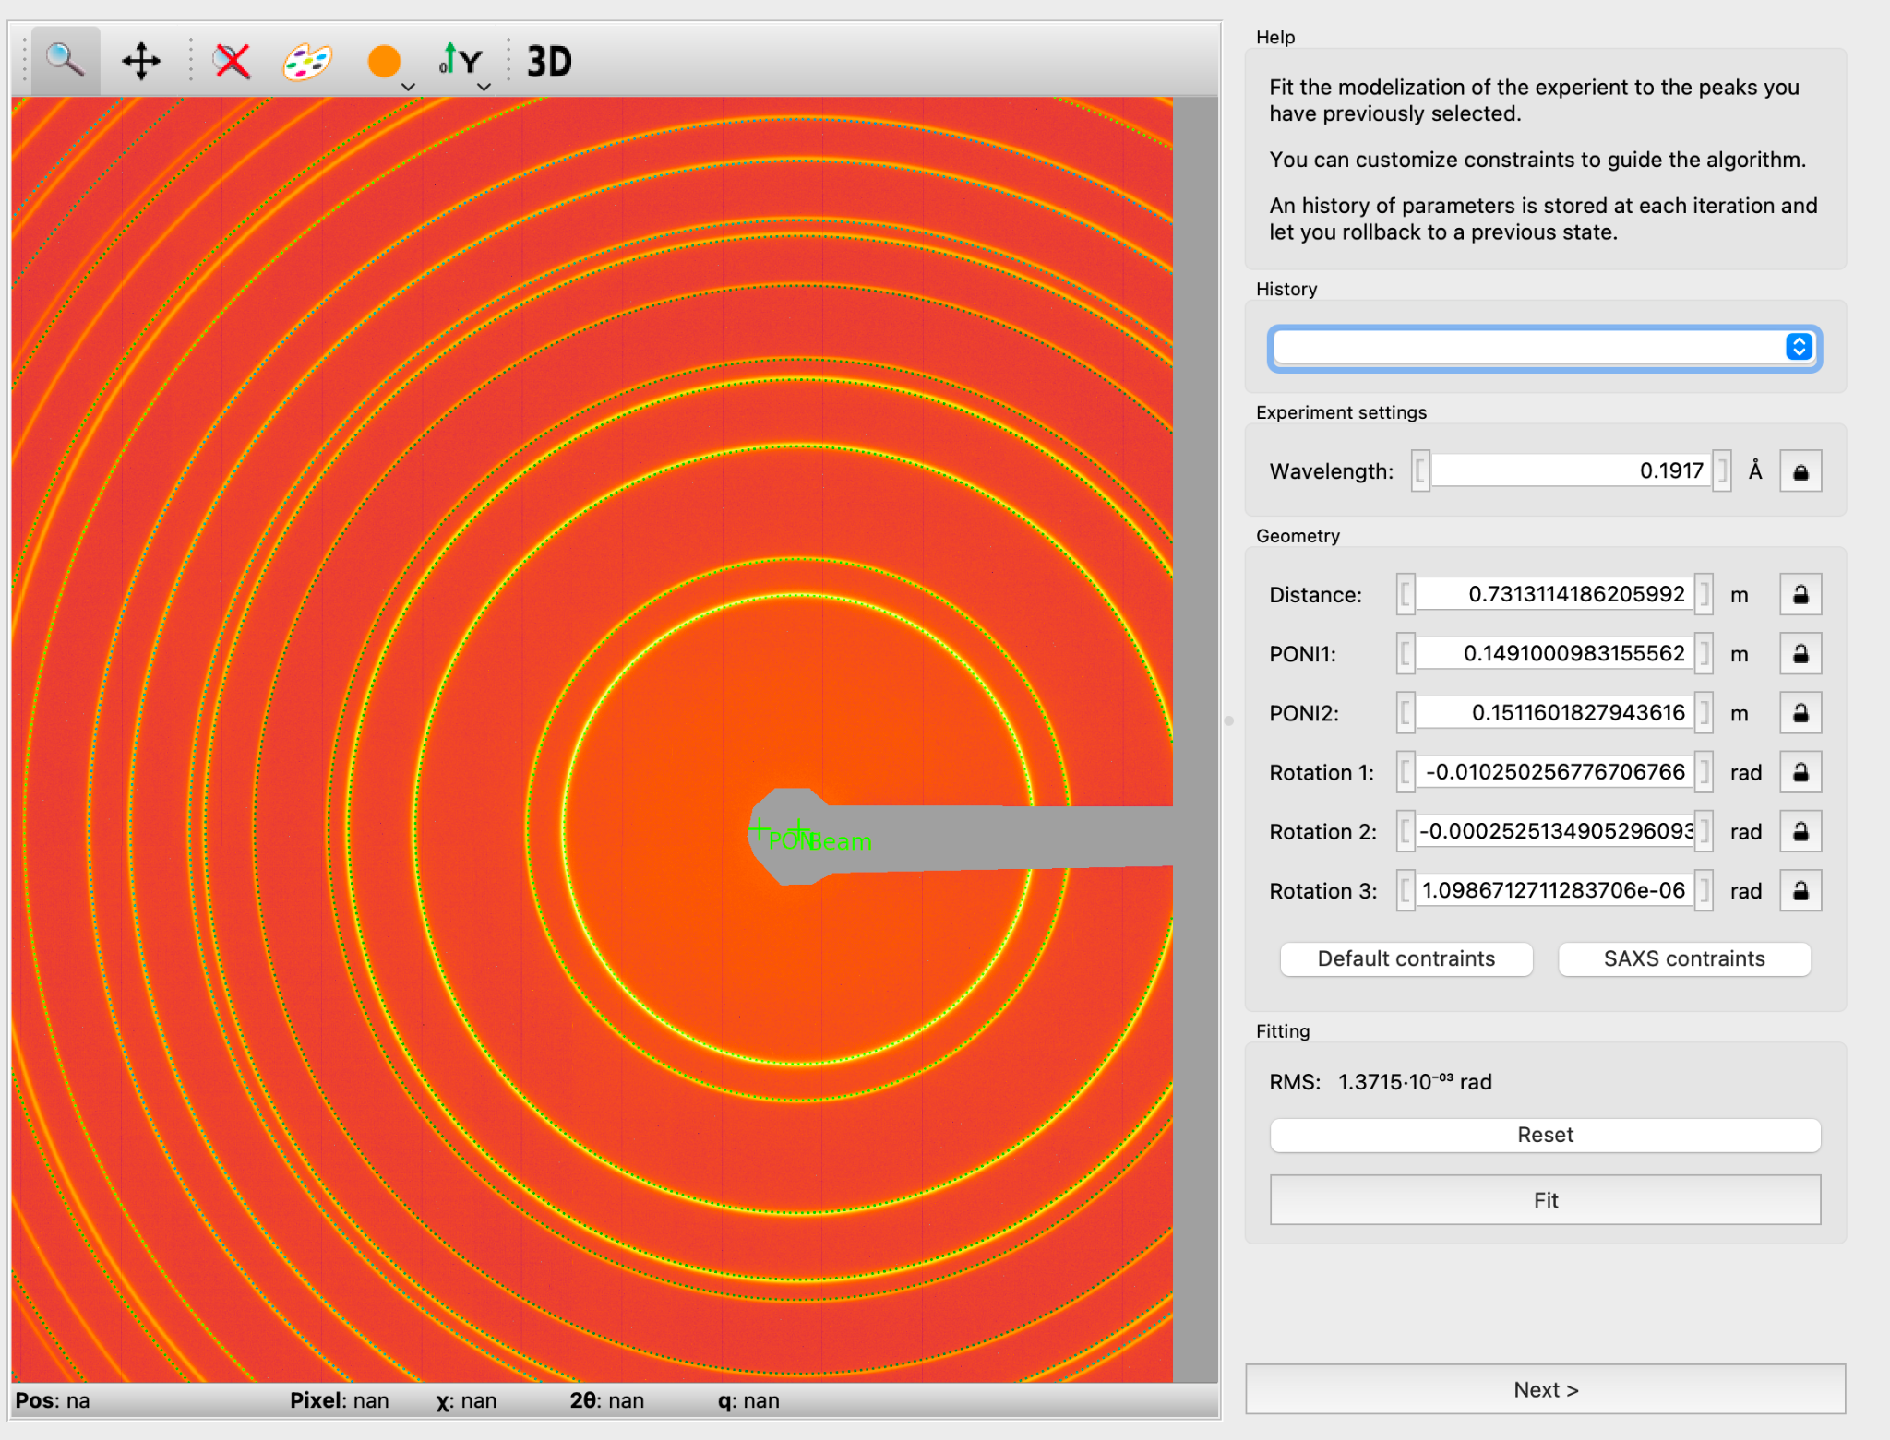
Automatic Calibration
The PONI (point of normal incidence) and the Beam location, should be automatically located based on the rings, as well as some additional parameters.
Now we are ready to integrate.

Slide 19
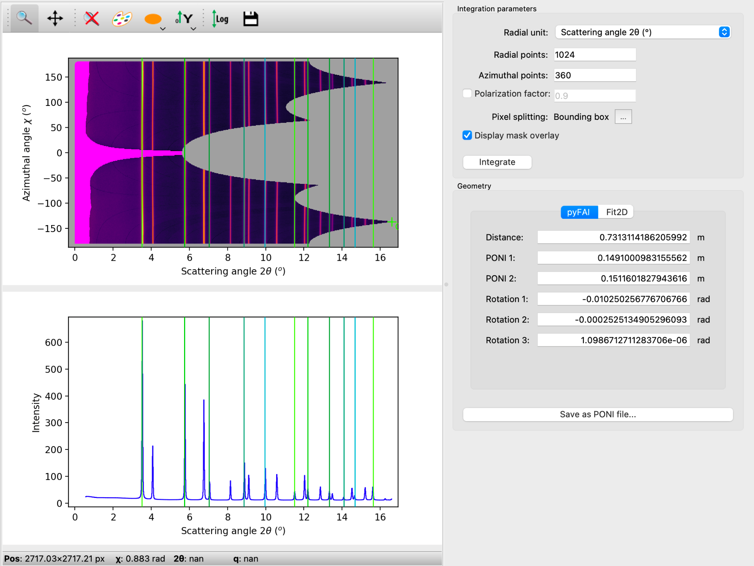
Integration
Once you continue from the calibration, the 2D cake pattern, and the azimuthal integration of the intensity should be automatically created.

Slide 20
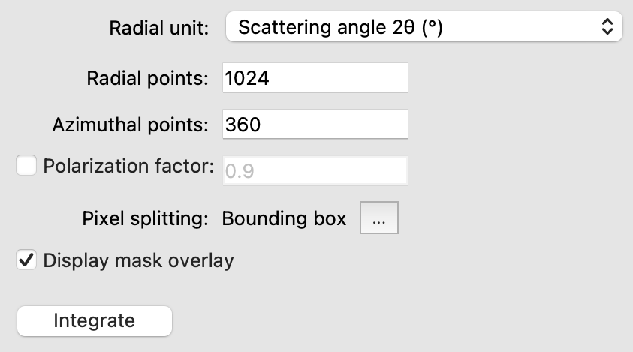
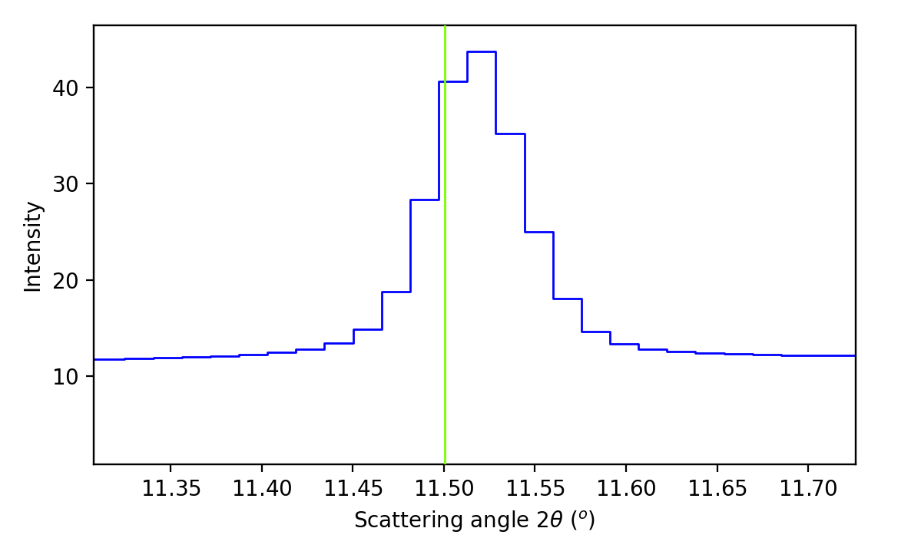
Integration: Parameter Adjustment
The graphical cells are interactive; zoom in by selecting a rectangular region on either plot (to exit zoom, press the looking glass with the red X over it).
Upon zooming one of the further peaks, we see that it is very jagged; we can deal with this by increasing the number of radial points (essentially increasing the bin count).

Slide 21
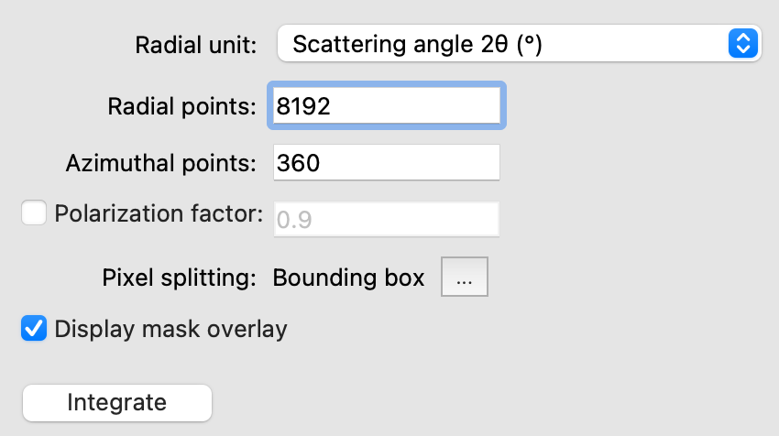
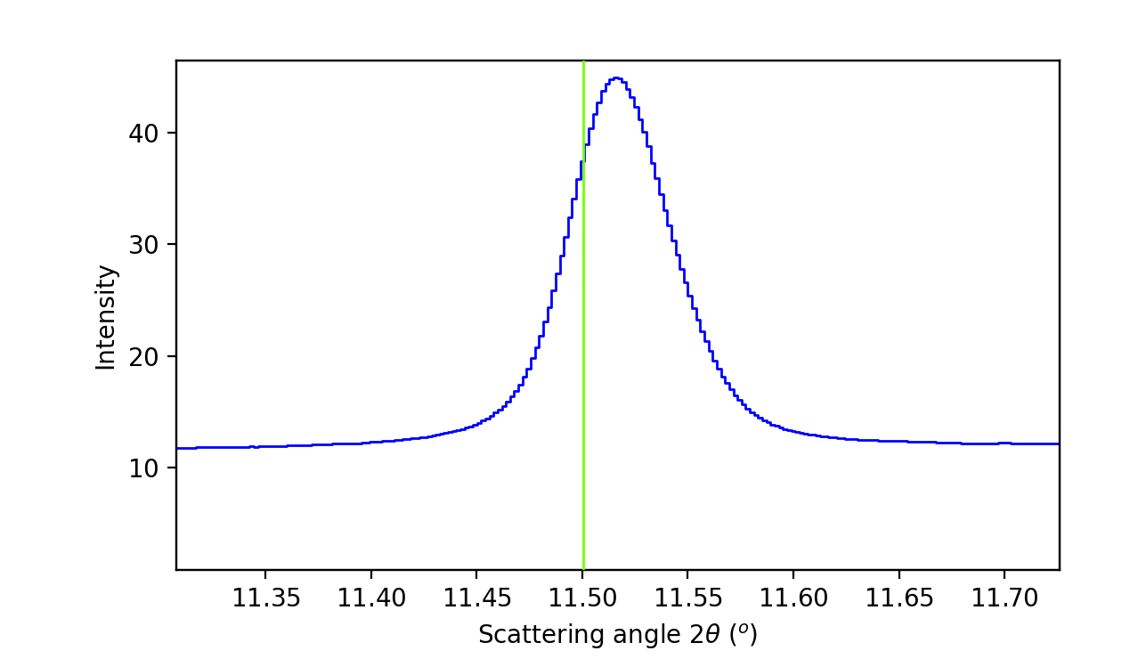
Integration: Parameter Adjustment
Increasing from 1024 by a factor of 8 yields a much nicer peak with little computational increase!

Slide 22
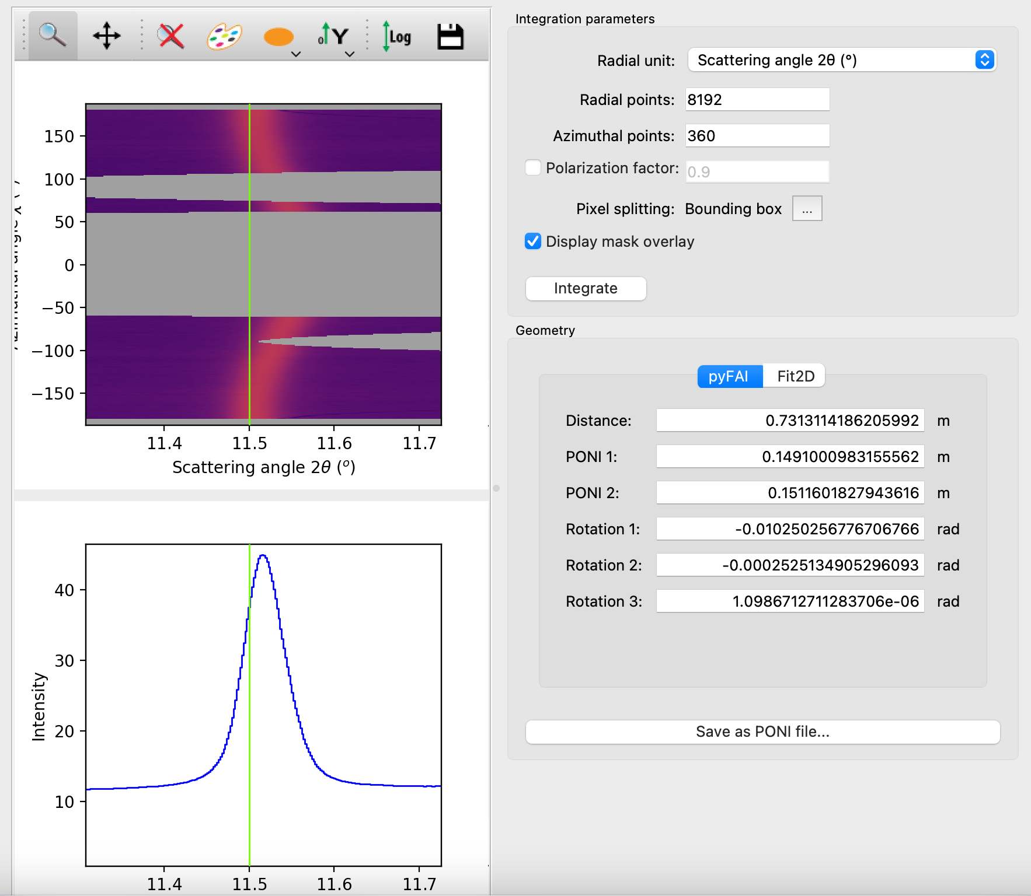
Integration: Getting your Result
Select the Save icon at the the top to save Intensity vs 2Theta data as a CSV.
Select “Save as PONI file…” to save your calibration as a PONI file.
Later, if you prefer to redo integration with the pyFAI python tool instead of the GUI, you can import this PONI file.
(*) The peak in this page is a bit off. This will be addressed later.

Slide 23
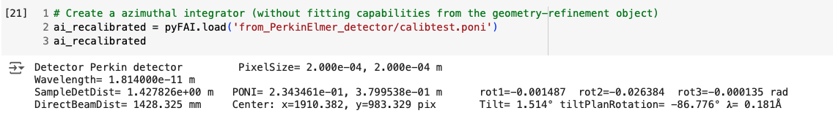
Riding your PONI into Colab
In the pySULI folder on Colab, upload your PONI file somewhere notebook 003 can easily access it.
Edit the cell on the left so that ai_recalibrated loads from YOUR PONI file, and not the one created earlier in the notebook.
PONI can be read with pyFAI.load()

Slide 24
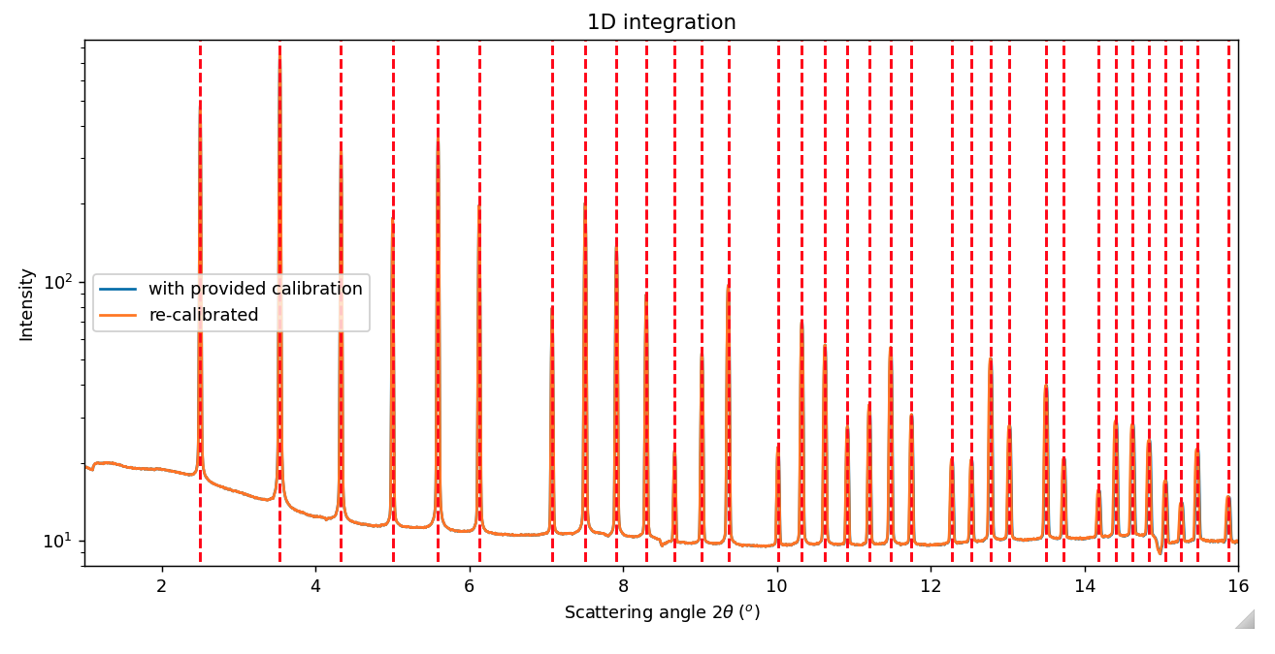
The output shows our calibration was successful.

